Slide 1
CS250 Lecture 43 – Benchmarking and hardware testing
2017.12.06
Fool me once, shame on you.
Fool me twice, shame on me.
– a saying

Slide 2
Assignment
Read chapters 21 and 22; skim chapter 19
Perhaps use your regular lab session time to take the practice final exam

Slide 3
Final exam coverage and format
Final exam covers
Textbook chapters 1 through 22
All lectures
All homeworks
All labs
Final exam format
50 multiple choice questions at 3 pts. each
Some emphasis on material since Midterm 2, yet, comprehensive coverage of the semester
Closed book, closed notes, no calculators

Slide 4
Announcement
Course evaluation survey is open until Sunday
I welcome your comments and will use them to improve the course
Thank you for paying it forward to CS students
Notes:
Was 21 and 18 on Friday, Dec. 01

Slide 5
Assessing performance
Purpose: inform hardware and software selection
Principal problems
Computers can be used for a very large variety of computational tasks
Architectural design that excels for one task may fall far behind different designs for other tasks
CPU time may determine performance, then again memory access time or I/O time may dominate instead
Performance (execution time or throughput) often depends in specific input data, not just the size of the data

Slide 6
Consequence
Many try to assess computer performance
Many measures of performance have been tried
No single measure suffices for all situations

Slide 7
Early measures of computer speed
Integer computation speed
Relevant for many applications
Units were millions of (integer) instructions per second (MIPS)
Floating point computation speed
Used for scientific/engineering computations
Typically involves matrices
Units are floating point operations per second (FLOPS)

Slide 8
Problems with early measures
Performance measures based on instruction execution rate are poor-quality
Why?
Because instruction execution rate does not correlate with program execution time across different computers, and not even across different models of the same computer
Comparison is the purpose of attempting to measure performance

Slide 9
Early attempt to address workload variety
Because programs vary so much in how they make use of the instructions of a computer try using a “average instruction mix”
Obtain relative frequency of different instructions from a large set of programs
Attempt to mimic a typical workload of programs
Use relative instruction frequency to derive MIPS
Assess a proposed architecture based on this MIPS
Still a poor-quality measure because no single program correlates with the average “mix”

Slide 10
Chaos, uselessness, and fraud
Each company uses a bespoke, one of a kind, benchmark
In practice, each company “cherry-picks” one program or one mix as a benchmark, and publishes its MIPS or FLOPS; this is called “benchmarketing”, a portmanteau of benchmark and marketing (chaos)
Thus, customers cannot use these MIPS or FLOPS to compare computers from different vendors (useless)
Worse, some benchmarks become popular among customers, tempting vendors to
Silently pad benchmark with NOPS, which run at the peak speed on most computers, then report the inflated MIPS or FLOPS measurement (fraud)
Notes:
A nice portmanteau of benchmark and marketing; another portmanteau: BRUNCH from Breakfast and Lunch; podcast from iPod and Broadcast; smog from smoke and fog

Slide 11
Revolt led to standardized benchmarks
Benchmark workload provided in fixed source code
Results reported as
Time (response or throughput) on a specific
Hardware configuration as achieved by a
Compiler specified by version and all flag settings
Report provides all the information necessary to independently buy the hardware and software and reproduce the measurement
A much better approach; results correlate with time (response or throughput) and well-designed benchmark can exercise all aspects of a computer

Slide 12
SPEC.org – Standard Performance Evaluation Corporation
SPEC founded in 1988 by workstation vendors
Non-profit to establish, maintain and endorse standardized benchmarks and tools to evaluate performance and energy efficiency for the newest generation of computing systems
SPEC develops benchmark suites and also reviews and publishes submitted results from member organizations and other benchmark licensees
Benchmarks available for Cloud, CPU, Graphics/Workstations, ACCEL/MPI/OMP, Java Client/Server, Mail Servers, Storage, Power, Virtualization, Web Servers – new benchmarks added as needed
Notes:
who realized that the marketplace was in desperate need of realistic, standardized performance tests. The key realization was that an ounce of honest data was worth more than a pound of marketing hype.

Slide 13
SPEC members (from web page April 2017)
SPEC Members:
Acer Inc. * Action S.A. * Advanced Micro Devices * Amazon Web Services, Inc. * Apple Inc. * ARM * Avere Systems * Bull SAS * Cavium Inc. * Ciara Technologies Inc. * Cisco Systems, Inc. * Dell, Inc. * Digital Ocean * E4 Computer Engineering SPA * Fujitsu * Gartner, Inc. * Hitachi Data Systems * Hitachi Ltd. * Hewlett Packard Enterprise * HP Inc. * Huawei Technologies Co. Ltd. * IBM * Inspur Corporation * Intel * Lenovo * M Computers s.r.o. * Microsoft * NEC - Japan * NetApp * New H3C Technologies Co., Ltd. * NVIDIA * Oracle * OVH SAS * Primary Data * Principled Technologies * Pure Storage * Qualcomm Technologies Inc. * Quanta Computer Inc. * Red Hat * Samsung * SAP AG * Seagate * Sugon * Super Micro Computer, Inc. * SUSE * Symantec Corporation * Taobao (China) Software Co. Ltd. * Unisys * Veritas Technologies * Via Technologies * VMware *
SPEC Associates:
Acadamia Sinica, Institute of Information Science * Argonne National Laboratory * Charles University * China Academy of Telecommunication Research * Dresden University of Technology ZIH * fortiss GmbH * Helmholtz-Zentrum Dresden Rossendorf (HZDR) * Indiana University * JAIST * Karlsruhe Institute of Technology * Leibniz Rechenzentrum - Germany * National University of Singapore * Oak Ridge National Laboratory * Ohio State University * Pennsylvania State University * Purdue University * RWTH Aachen University * Technische Universität Darmstadt * Technische Universität Dresden * Tsinghua University * University of Aizu - Japan * University of California - Berkeley * University of Cologne * University of Delaware * University of Illinois at Urbana-Champaign * University of Maryland * University of Miami * University of Texas at Austin * University of Tsukuba * University of Wuerzburg * Virginia Polytechnic Institute and State University *
SPEC Research Group:
Advanced Strategic Technology LLC * ARM * bankmark UG * Barcelona Supercomputing Center * BEZNet * Charles University * Cisco Systems * Cloudera, Inc * Compilaflows * Delft University of Technology * Dell * fortiss GmbH * Friedrich-Alexander-University Erlangen-Nuremberg * Goethe University Frankfurt, Big Data Lab * Hewlett Packard Enterprise * Huawei * IBM * Imperial College London * Institute for Information Industry, Taiwan * Intel * Karlsruhe Institute of Technology * Kiel University * Lund University * Microsoft * NICTA * NovaTec Consulting GmbH * Oracle * Purdue University * Queen's University * Red Hat * RWTH Aachen University * SalesForce.com * San Diego Supercomputing Center * San Francisco State University * SAP AG * SINTEF * Software Performance and Scalability Consulting * Tata Consultancy Services * Technica Corporation * Technische Universität Darmstadt * Technische Universität Dresden * The MITRE Corporation * Umea University * University of Alberta * University of Coimbra * University of Lugano * University of Minnesota * University of North Florida * University of Paderborn * University of Stuttgart * University of Texas at Austin * University of Wuerzburg * VMware * York University *

Slide 14
Example SPEC benchmarks
SPEC Cloud_IaaS 2016
SPEC CPU2006 – compute-intensive workload; contains CINT2006 (integer) and CFP2006 (floating point)
Earlier version, SPEC CPU2000, is retired
Report of running a SPEC benchmark is called a SPECmark

Slide 15
Increasing overall performance
Hardware designed for a specific computation is faster than and will use less energy than software for that same computation running on general purpose hardware
Improve performance by
Adding special-purpose hardware
Graphics processing unit (GPU), etc.
Subtracting certain purposes
iOS forbids software-only video decoding (e.g., Adobe Flash), allows hardware-supported video decoding to achieve exceptional battery performance
Subtracting functionality to make room for differentiating new functionality is an example of a Blue Ocean Strategy

Slide 16
Benchmarking summary
Checkered benchmarking history led to SPECmarks
Time (response or throughput) is the agreed upon measurement
Using a standardized source-code workload and reporting compiler and hardware details yields meaningful/useful time measurements
Amdahl’s Law can be applied to benchmark results on a program-by-program basis to focus enhancement efforts

Slide 17
Performance fallacies and pitfalls
A fallacy is a commonly held misbelief or misconception
A pitfall is an easily made mistake

Slide 18
Performance fallacies
The relative performance of two processors with the same ISA can be judged by clock rate or by performance on a single benchmark
Why not? Because same ISA does not mean same pipeline, nor same memory system, thus
A better memory system (e.g., more levels of cache or bigger caches) can boost performance more than does increasing the clock rate
Adding pipeline stages can increase throughput enough to offset increases in clock rate
Performance typically varies widely across a set of benchmarks, so for any one benchmark performance may decrease for a processor that overall is better

Slide 19
Performance fallacies (cont.)
Benchmarks remain valid indefinitely.
Why not?
Standard benchmarks attract efforts to “crack” them via specialized optimizations (HW and SW)
Also, technology changes:
Example: SPEC89 benchmark included small program matrix300 comprising 8 different 300x300 matrix multiplies; 99% of execution time was 1 line of code
Compiler optimization called blocking gave 9x speedup for the IBM Powerstation 550
matrix300 now a test of compiler sophistication, but no longer a good test of hardware performance
Notes:
Here the 90/10 software rule became the 99/1 rule

Slide 20
What is blocking?
Partition an array into rectangular blocks small enough to avoid some cache and page misses that would accrue during operations iterating on large arrays across complete rows and columns
Choose subarray size to minimize paging and maximize use of items in cache blocks; that is, maximize hits in both cache and main memory

Slide 21
Naïve matrix multiply-add code
INTEGER I, J, K
REAL A(N,N), B(N,N), C(N,N)
DO J = 1, N
DO I = 1, N
A(I,J) = 0.0
END DO
END DO
DO I = 1, N
DO J = 1, N
DO K = 1, N
A(I,J) = A(I,J) + B(I,K) * C(K,J)
END DO
END DO
END DO
The loop nests initialize A and implement A = A + B * C. The K-loop performs a dot product of the I-th row of matrix B, with the J-th column of matrix C.
Every K-loop iteration references an entire column of B and row of C.
Initialize A(I,J)
+
x
Perform multiply-add

Slide 22
How to “block” a loop
To block a single, ordinary loop of N steps each of size 1:
DO I = 1, N, 1 (Example here is FORTRAN where DO loop = FOR loop
......... rather than the DO WHILE loop)
END DO
Replace it with nested loops where outer loop has ⎡N/IS⎤ iterations & inner loop iterates size 1 steps on ranges of size IS except final range of size N – IS*⎣N/IS⎦
DO IT = 1, N, IS (IS step size, iterate until IT > N)
DO I = IT , MIN(N, IT+IS-1), 1
.........................
END DO
END DO
Outer loop goes over the "blocks", inner loop traverses each block.
The block size, IS, should be choosen to fit in cache or one page
(whichever is smaller in total storage size).

Slide 23
Blocking, visually
DO IT = 1, N, IS
DO JT = 1, N, JS
DO KT = 1, N, KS
DO I = IT, MIN(N, IT+IS-1)
DO J = JT, MIN(N, JT+JS-1)
DO K = KT, MIN(N, KT+KS-1)
A(I,J) = A(I,J) + B(I,K) * C(K,J)
END DO
END DO
END DO
END DO
END DO
END DO
+
x
Data accesses are to 3 subarrays, of sizes IS*JS, IS*KS, and KS*JS, chosen to fit within cache or a page, minimizing misses.
This loop nest maximizes using data already paged in and already in cache at the expense of more program overhead for loop initializing and control. Q: Can this extra overhead be amortized?
Answer for IBM Powerstation 550: Yes!

Slide 24
Performance fallacies (cont.)
Fallacy: Observed performance, aka actual performance, tracks peak performance
Vendors may tout peak performance; our cmputer performs as high as this value.
Humorous translation: “Peak performance is the performance level the computer is guaranteed not to exceed.”
Gap between peak and observed performance is typically greater than a factor of 10; very poor tracking of peak by observed is typical

Slide 25
Performance pitfalls
Pitfall: Falling prey to Amdahl’s Law
We know Amdahl’s Law, yet we might expend a lot of effort optimizing some aspect of a system before we think to measure the frequency of usage of that aspect (to determine f_{e})

Slide 26
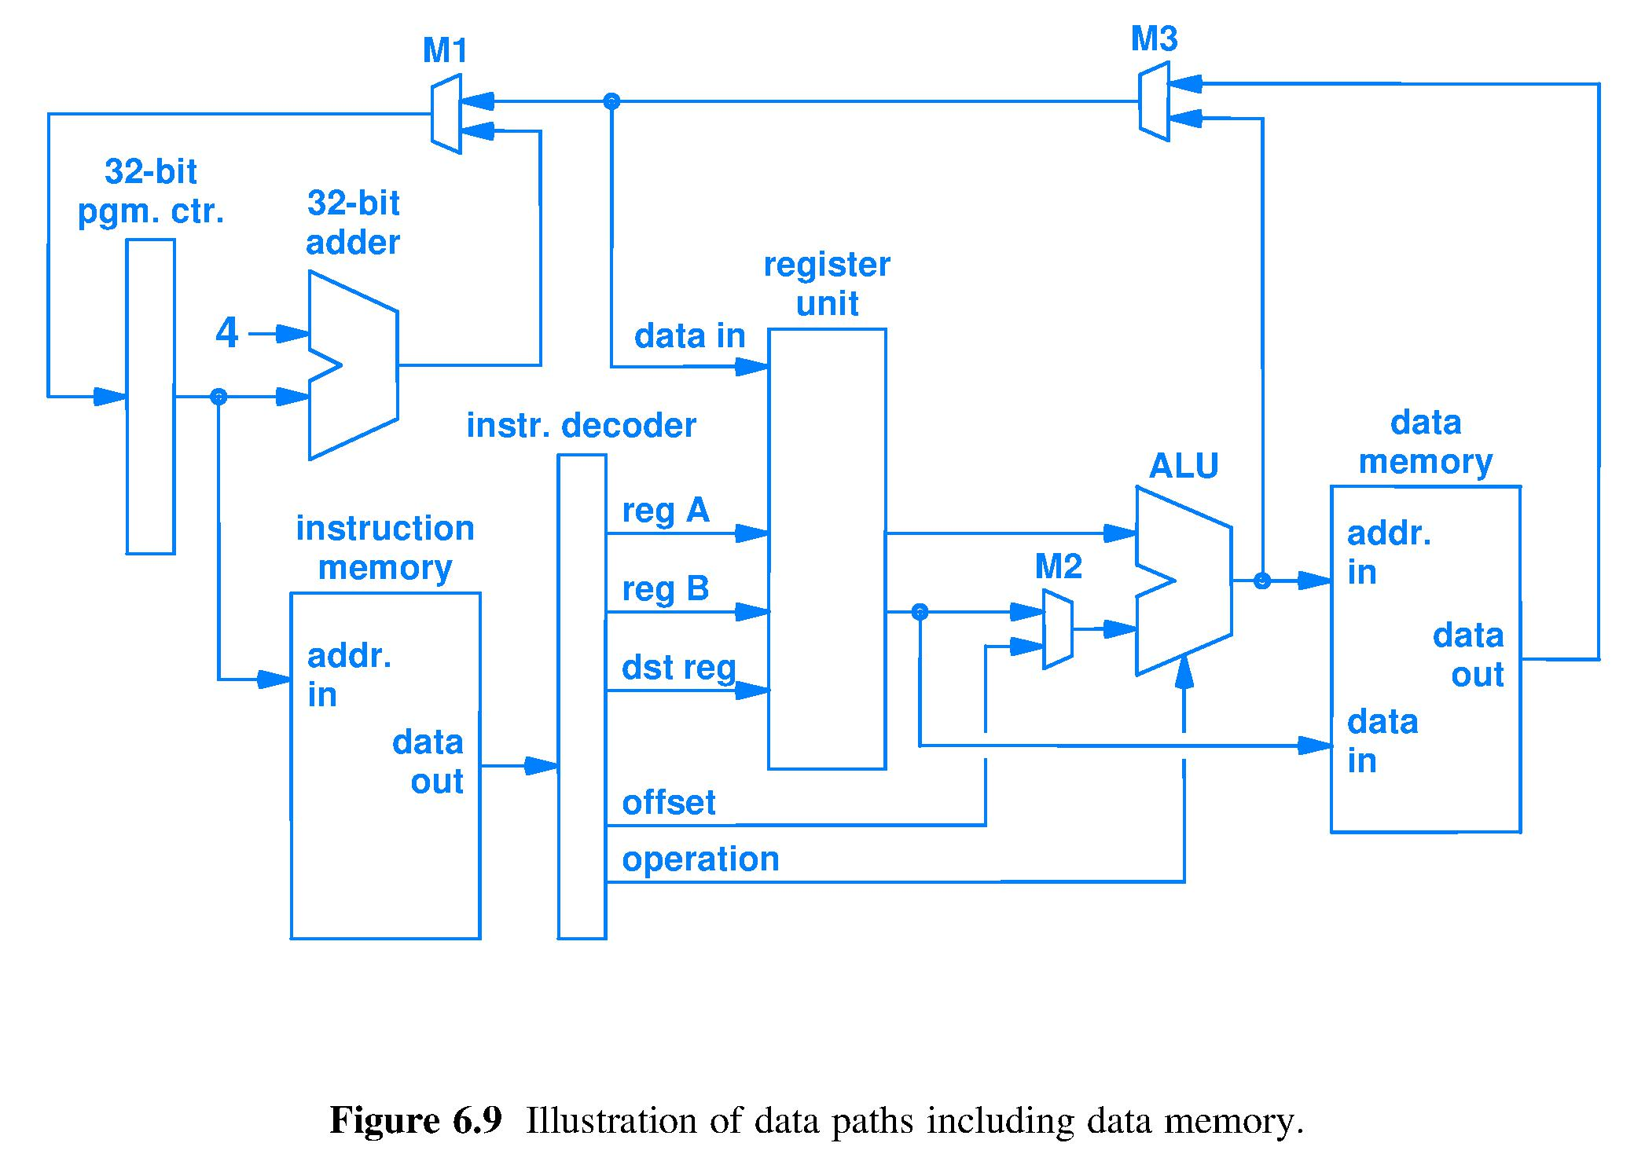
Testing hardware after manufacture
How do you test the hardware in a processor chip for correctness before selling it?
There are 2³² x 2³² distinct inputs for just the integer adder circuit within the ALU
At 4 Giga-tests/sec testing all possible integer adder inputs would take 4 Giga-seconds = 130 years
A (much) better way is needed
Notes:
Many silicon architectures such as PowerPC, MIPS, ARM, x86 built an entire software debug, instruction tracing, and data tracing infrastructure around the basic JTAG protocol.

Slide 27
Testing challenges
Number of tests needed to cover essential combinations of input data values
Delivering test patterns deep into the circuit
“Deep” gates and latches are those distant from chip I/O pins
Examining (outputting) test results from deep circuitry
Circuits on the paths to chip output pins will impose their own function on top of test results; can deep result be inferred?
Sequential circuits must be tested on data sequences, not independent input instances
Every micro-second spent testing adds to the cost of manufacturing a chip
How to expose faults anywhere in the entire circuit using a manageable number of quick tests?

Slide 28
Idea: Test port and scan design
Link all registers into one giant shift register
1) Shift in (load) a desired test pattern, 2) clock once to test each stage of logic, 3) shift out result to examine for correctness, 4) repeat with new test until done
1 pin
serial in
port
1 pin
serial out
port

